Slide 1
Strongly connected components
Akshat Mittal
2000101011

Slide 2
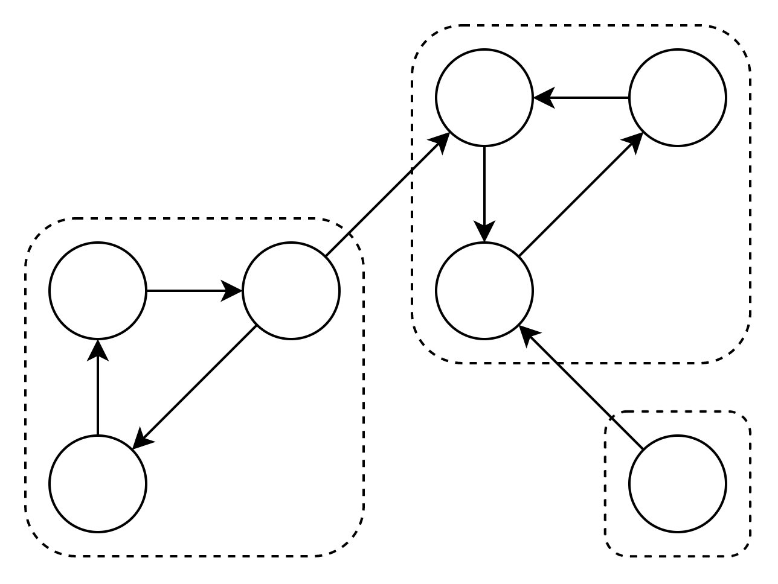
Introduction
A directed graph is strongly connected if there is a path between all pairs of vertices.
A strongly connected component (SCC) of a directed graph is a maximal strongly connected subgraph.
For example, there are 3 SCCs in the following graph:

Slide 3
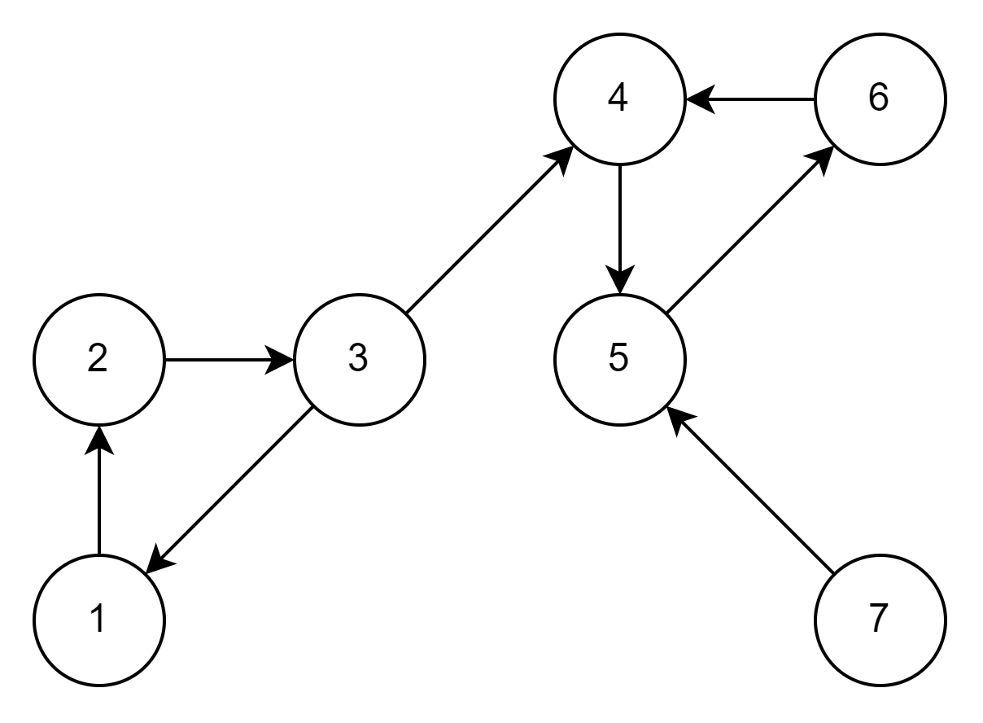
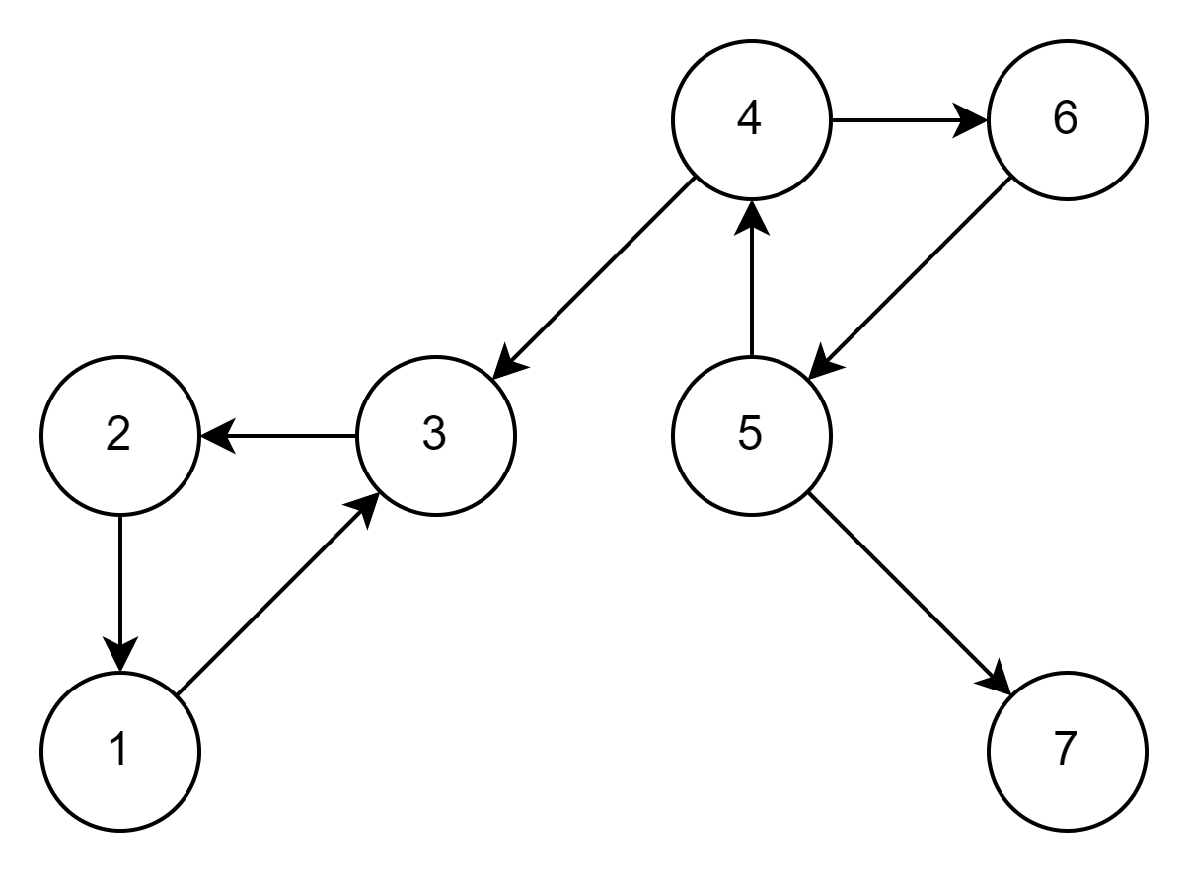
Transpose of a graph
Transpose of a directed graph G is another directed graph on the same set of vertices with direction of all the edges reversed.
For example:
Transpose

Slide 4
Kosaraju’s Algorithm
The Kosaraju’s algorithm is used find all the SCCs in a given graph G.
Following is detailed Kosaraju’s algorithm:
Create an empty stack and do DFS traversal of the graph G. In DFS traversal, after calling recursive DFS for adjacent vertices of a vertex, push the vertex to stack.
Compute Transpose of the graph; G^{T}.
One by one pop a vertex from stack while it is not empty. Taking popped vertex as source do DFS in G^{T}. The DFS starting from this vertex finds strongly connected component of the vertex in original graph G.

Slide 5
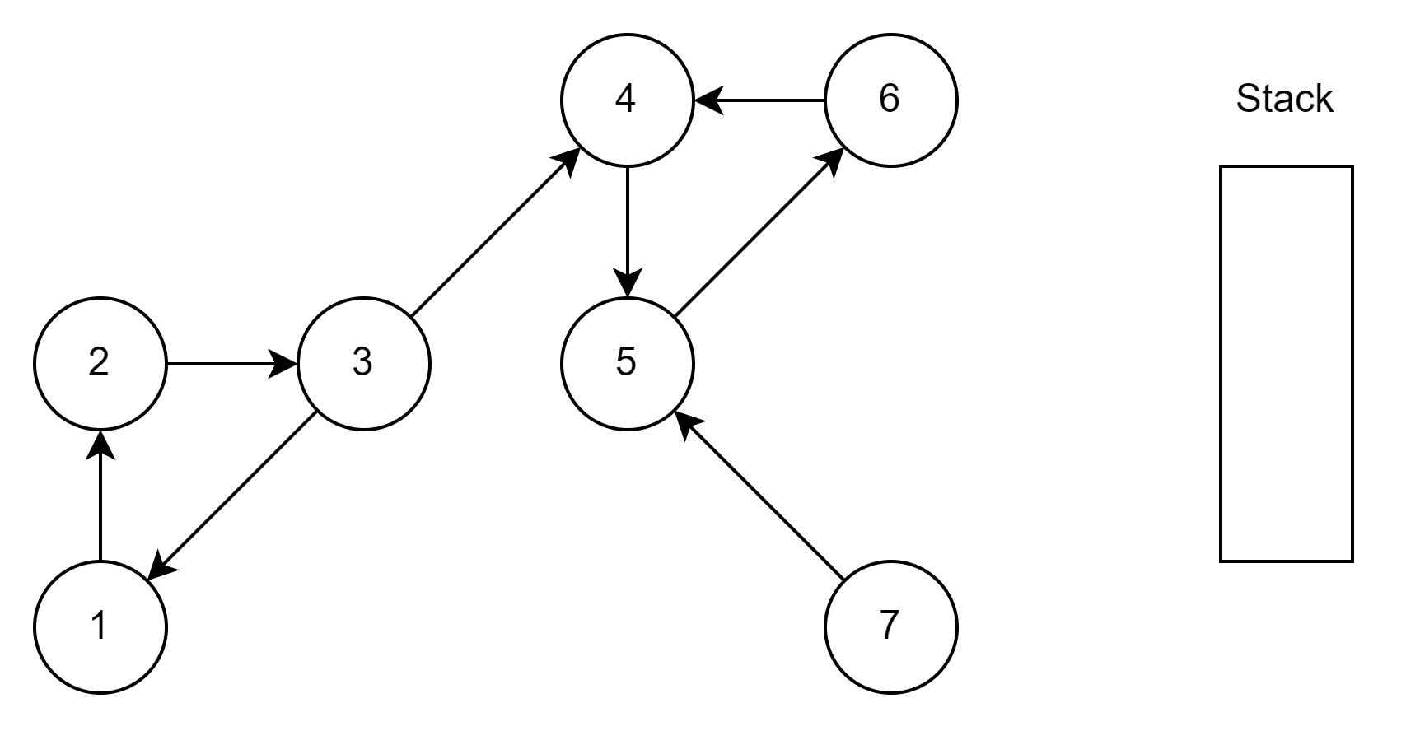
Illustration
Current

Slide 6
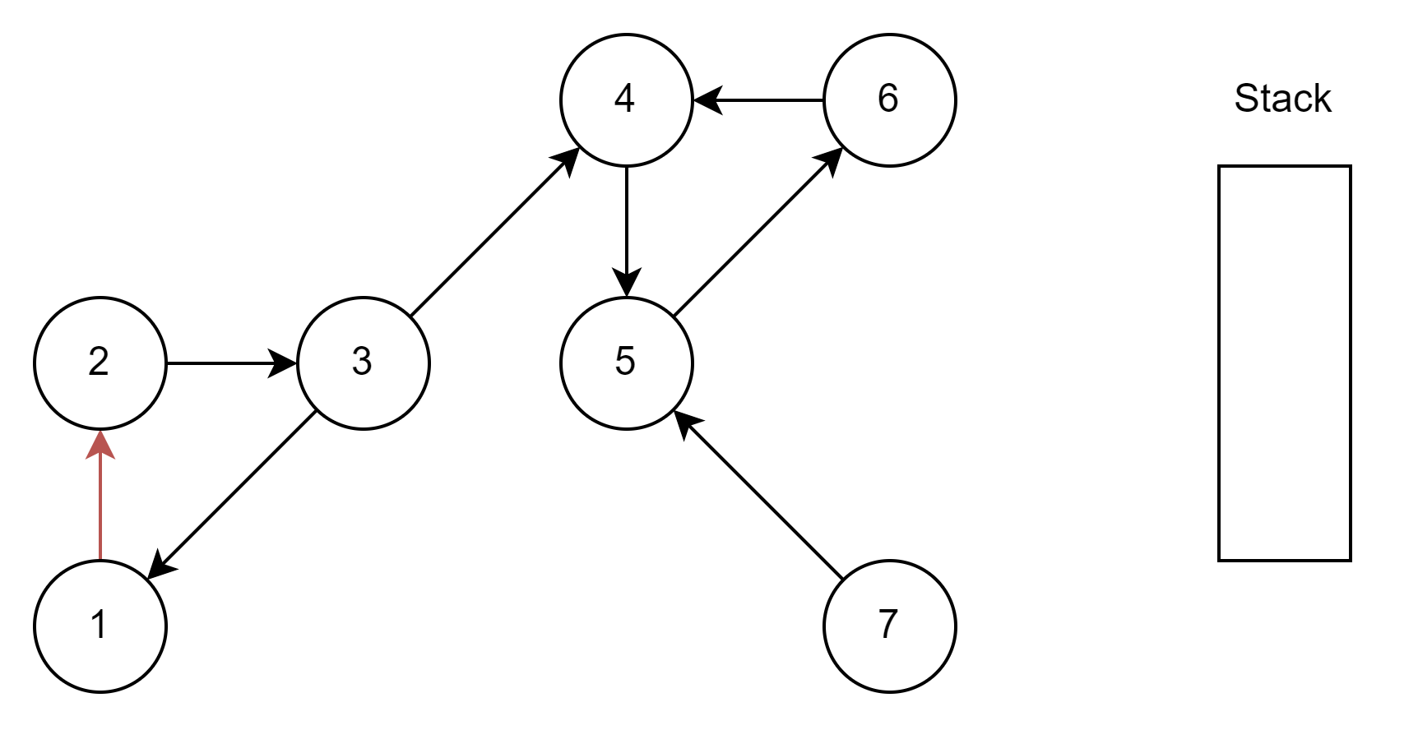
Illustration
Current

Slide 7
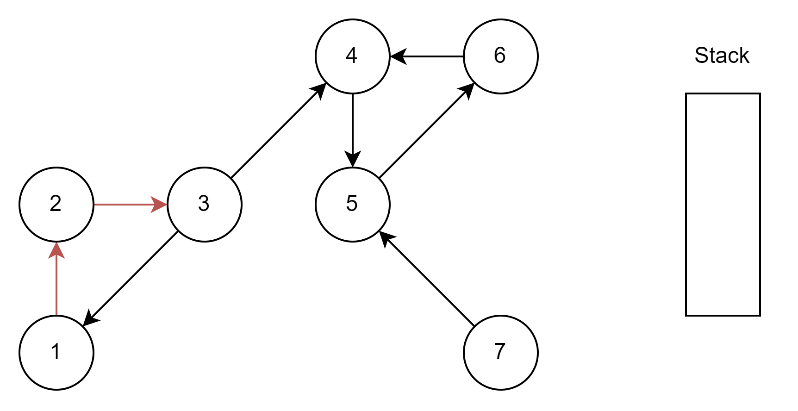
Illustration
Current

Slide 8

Illustration
Current

Slide 9
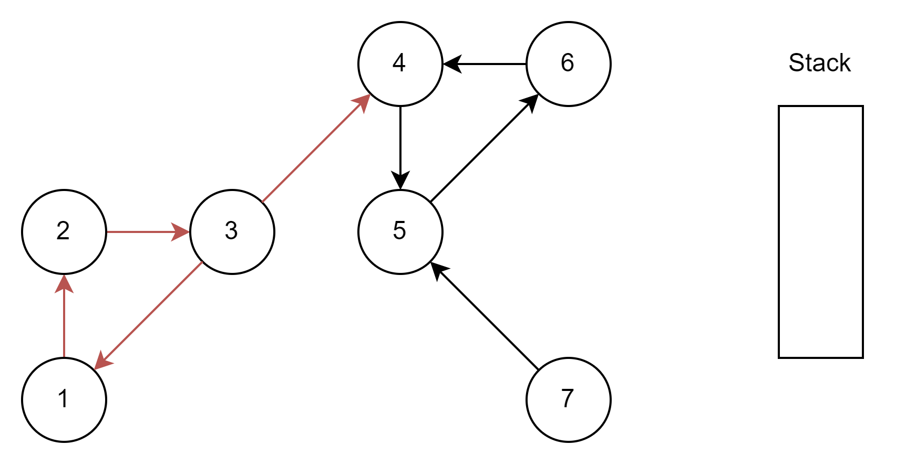
Illustration
Current

Slide 10
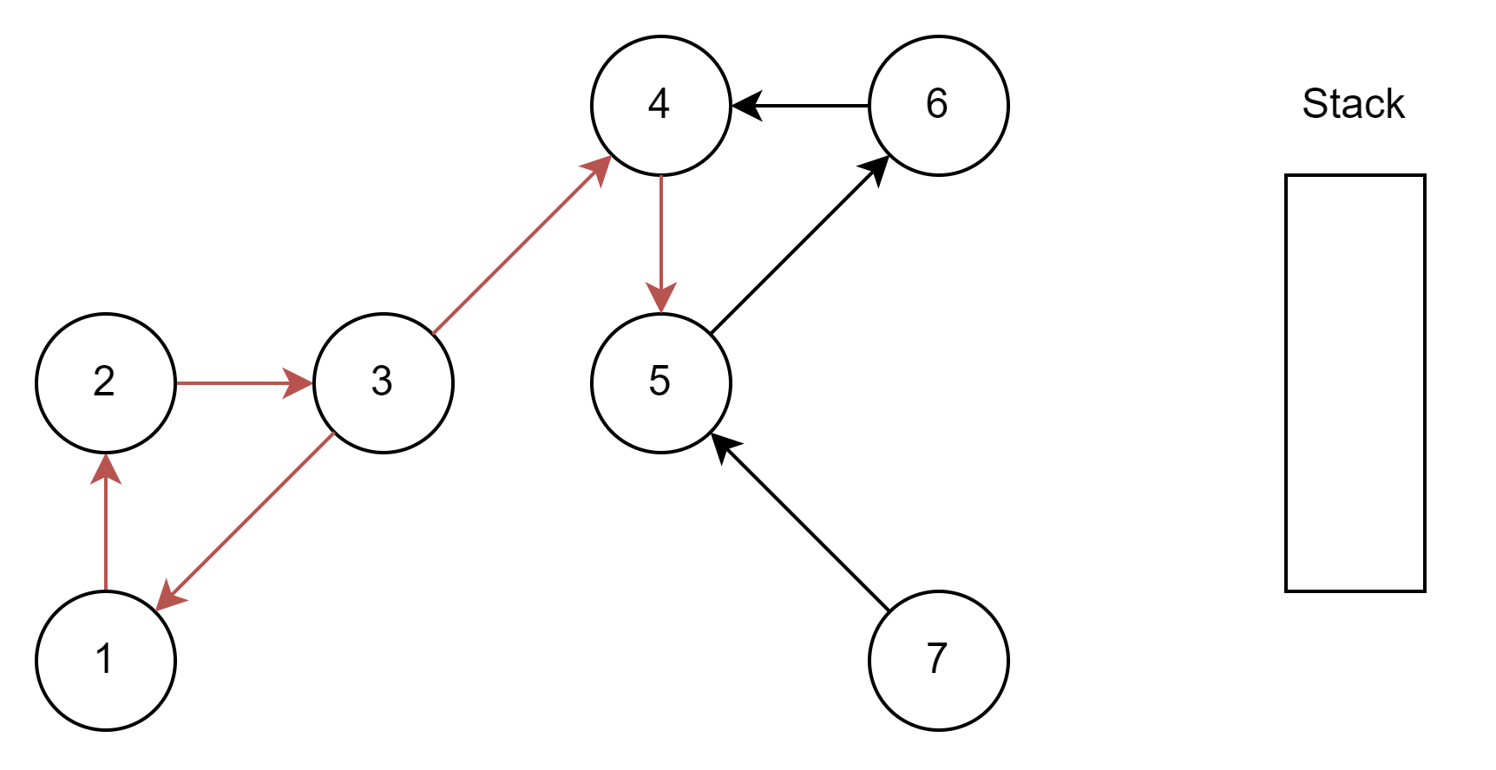
Illustration
Current

Slide 11
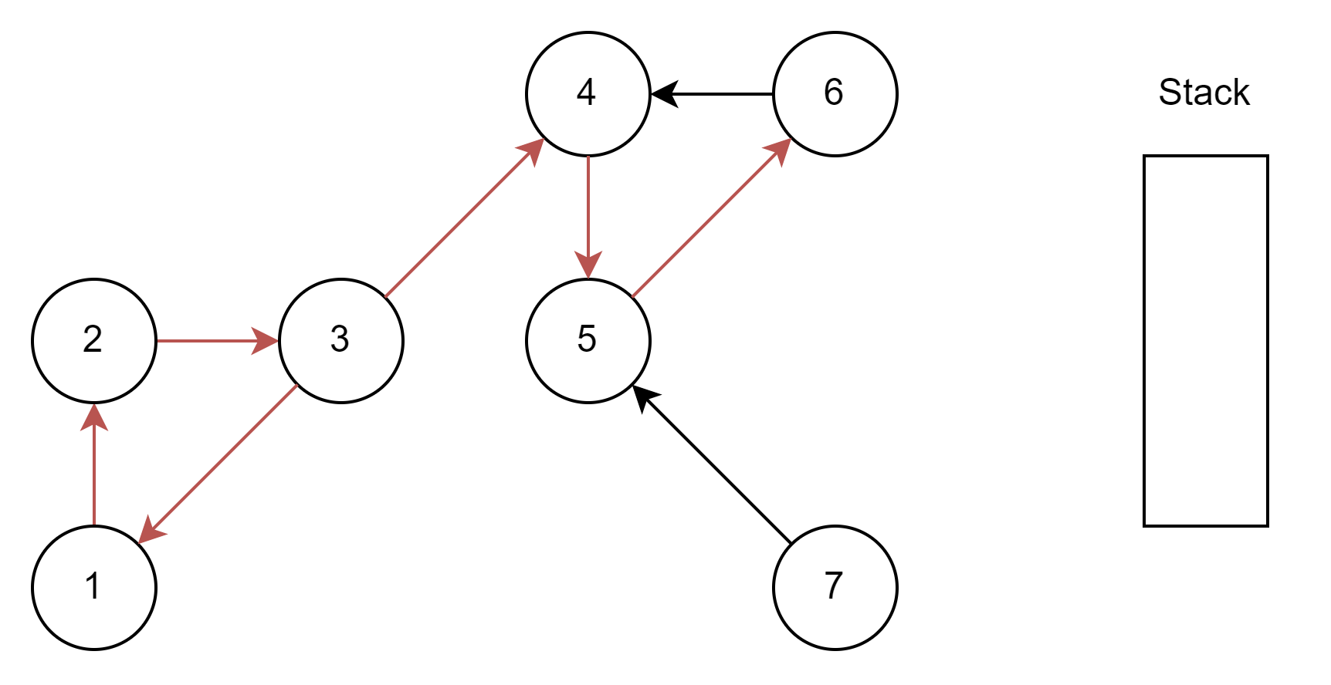
Illustration
Current

Slide 12
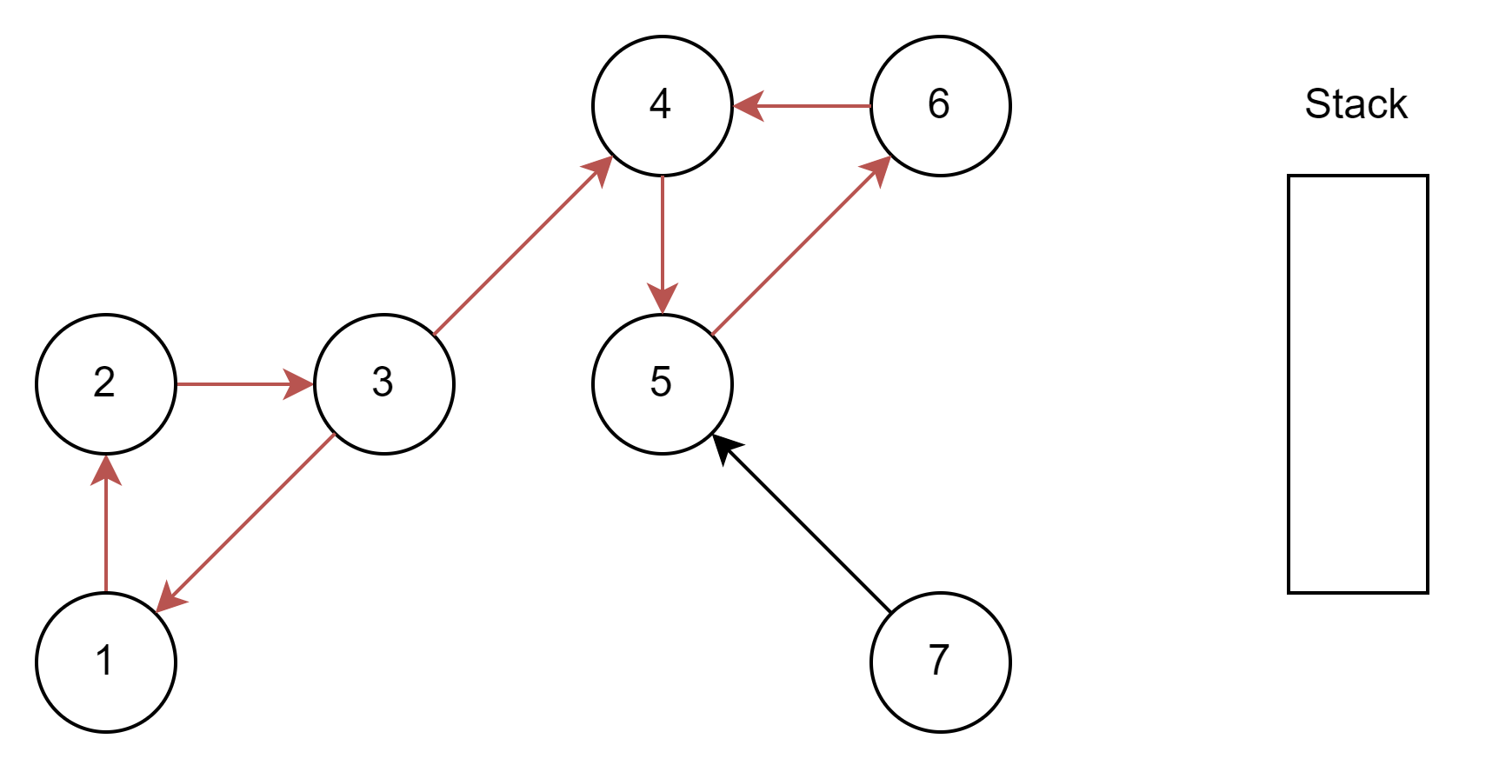
Illustration
Current

Slide 13
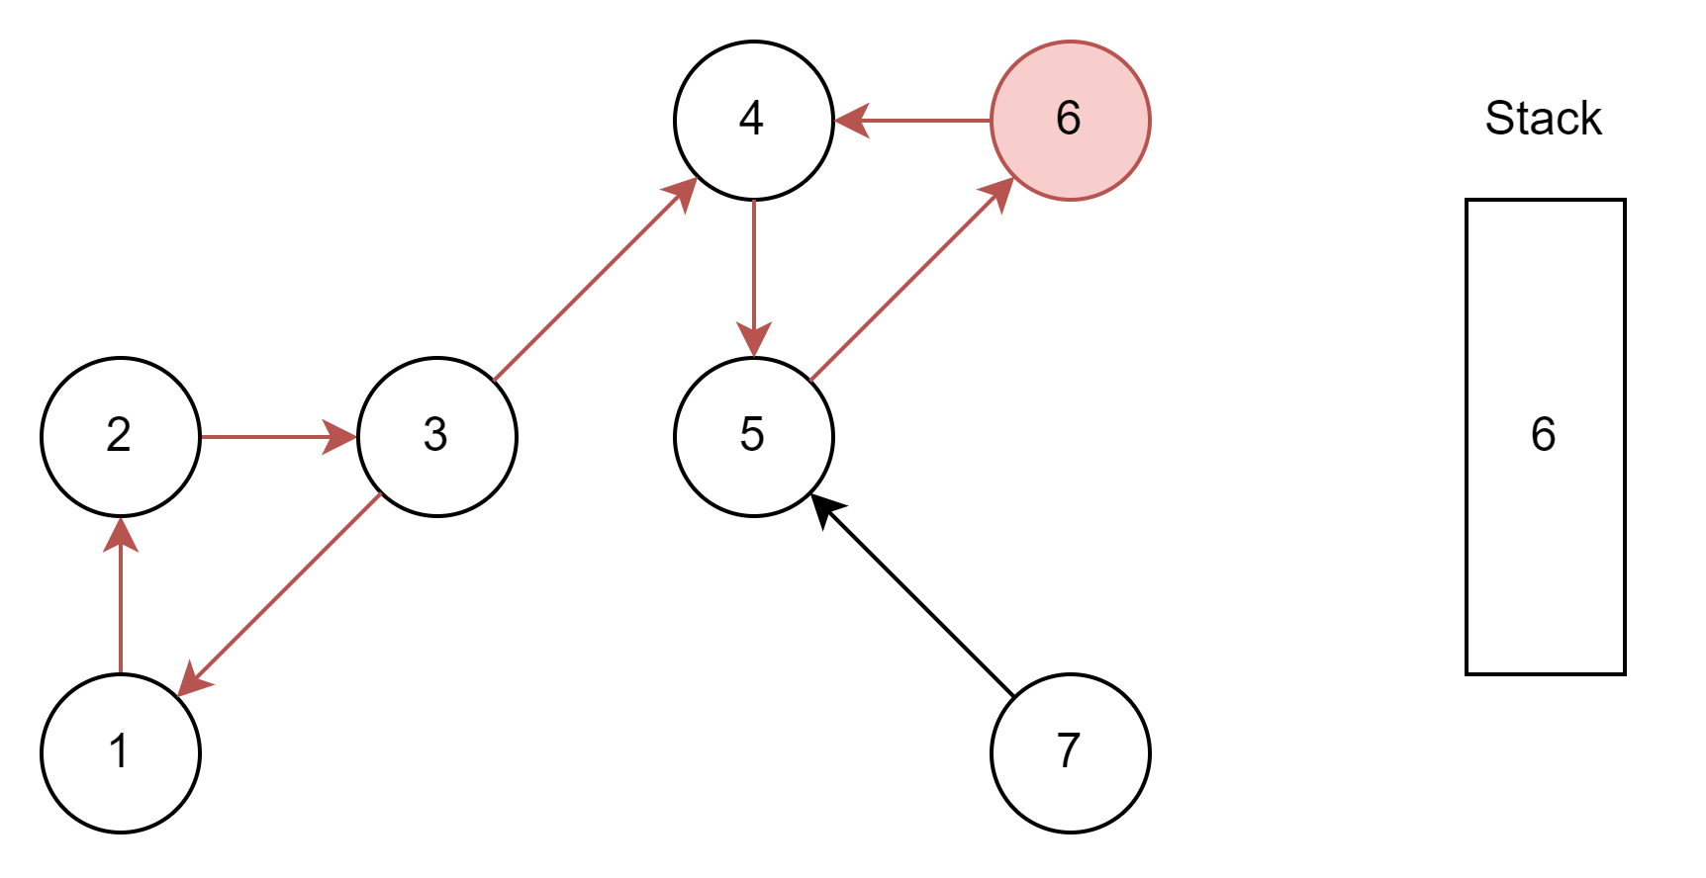
Illustration
Current

Slide 14
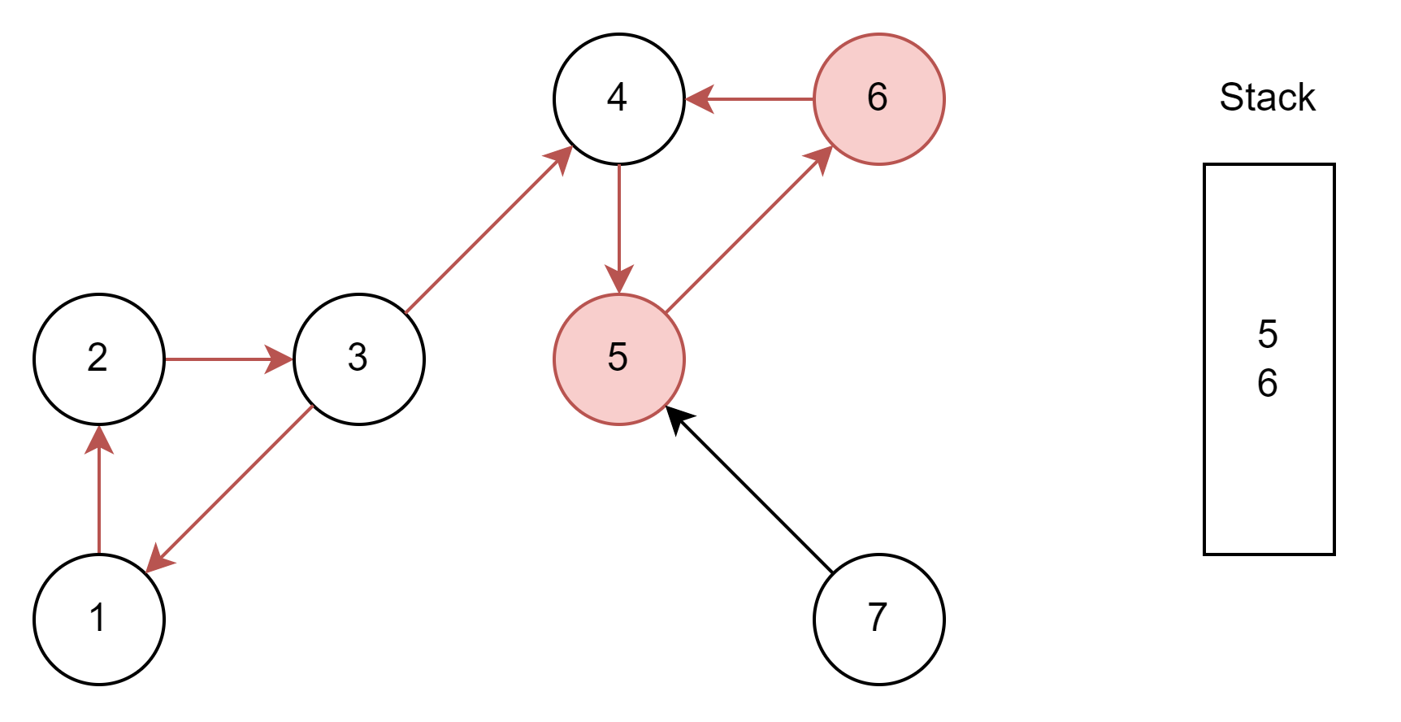
Illustration
Current

Slide 15
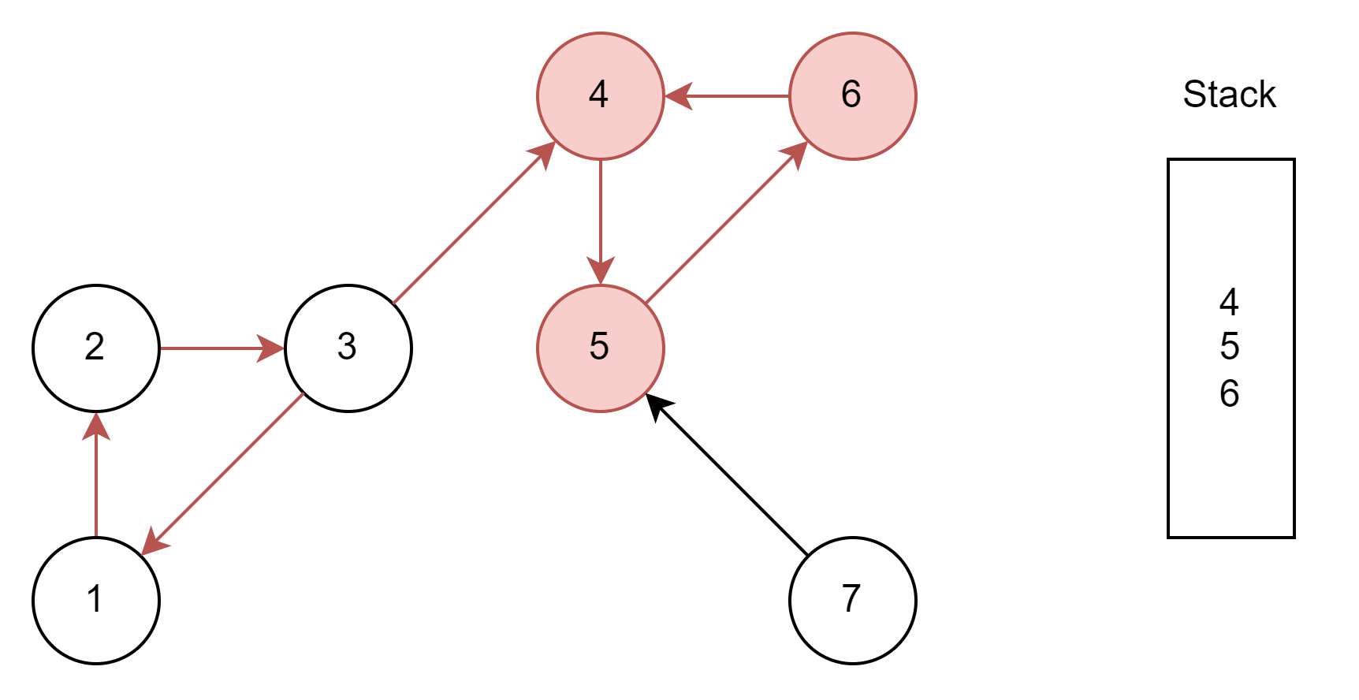
Illustration
Current

Slide 16
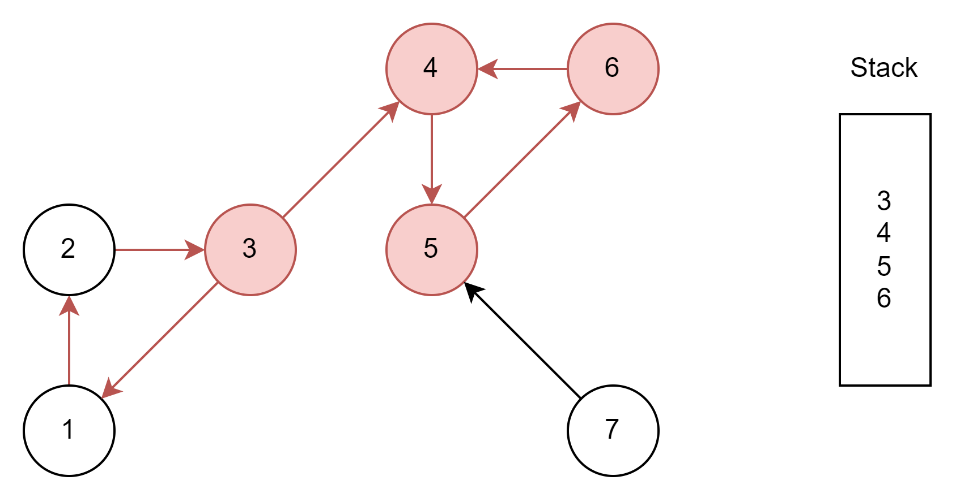
Illustration
Current

Slide 17
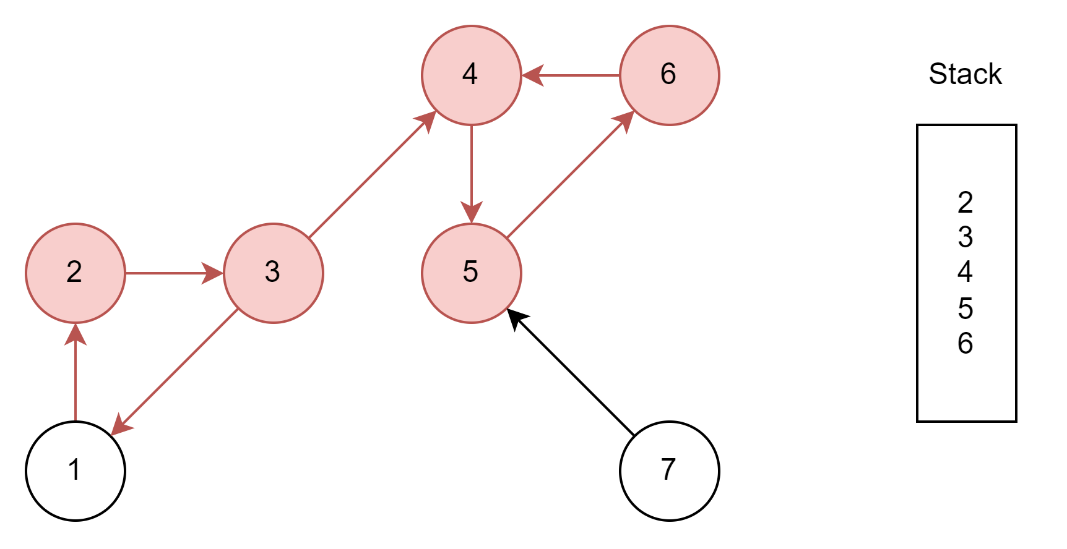
Illustration

Slide 18
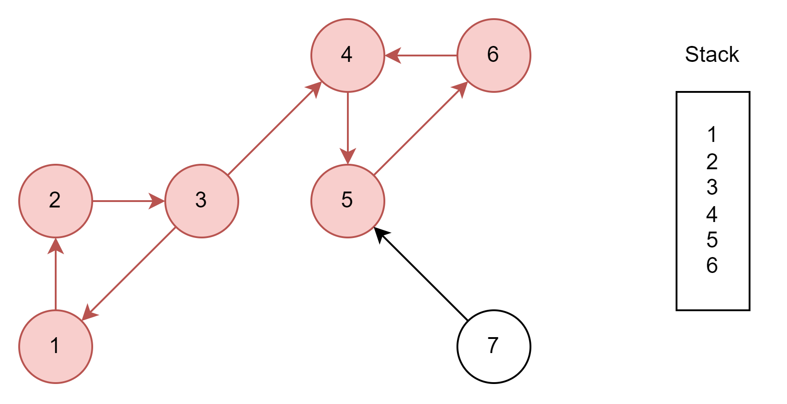
Illustration
Current

Slide 19
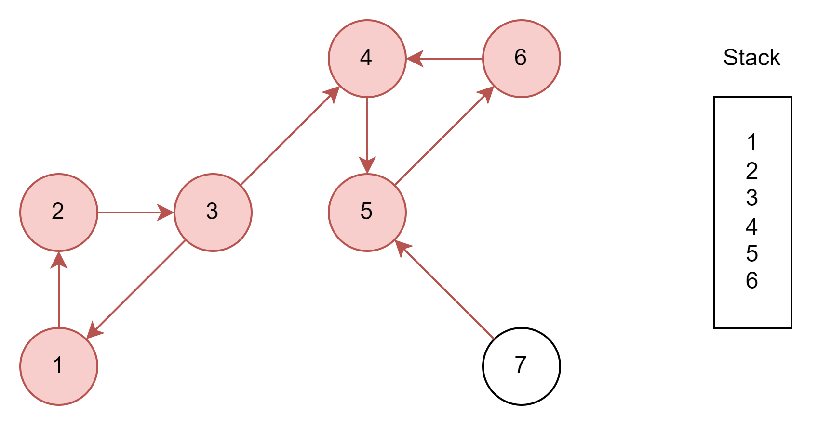
Illustration
Current

Slide 20
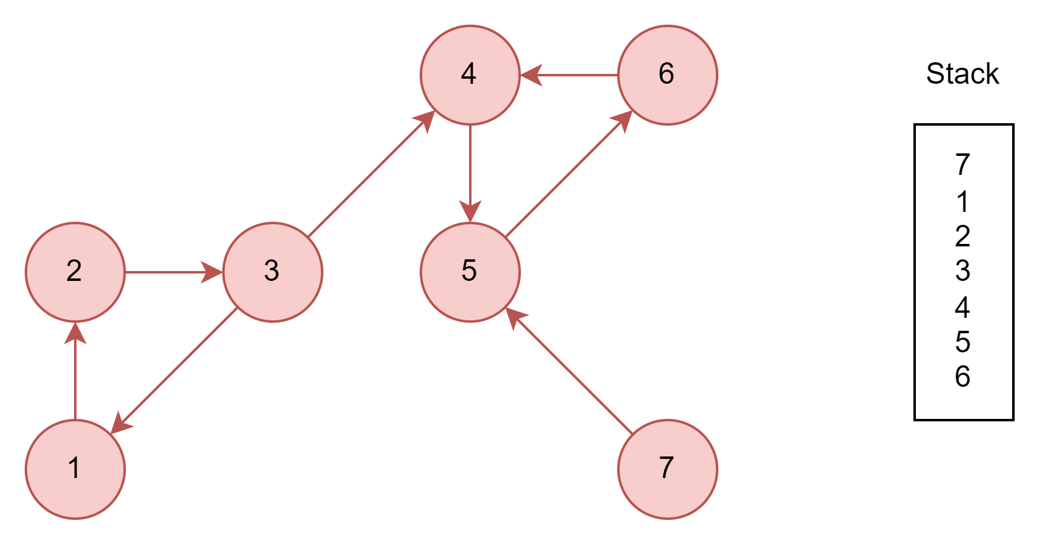
Illustration

Slide 21
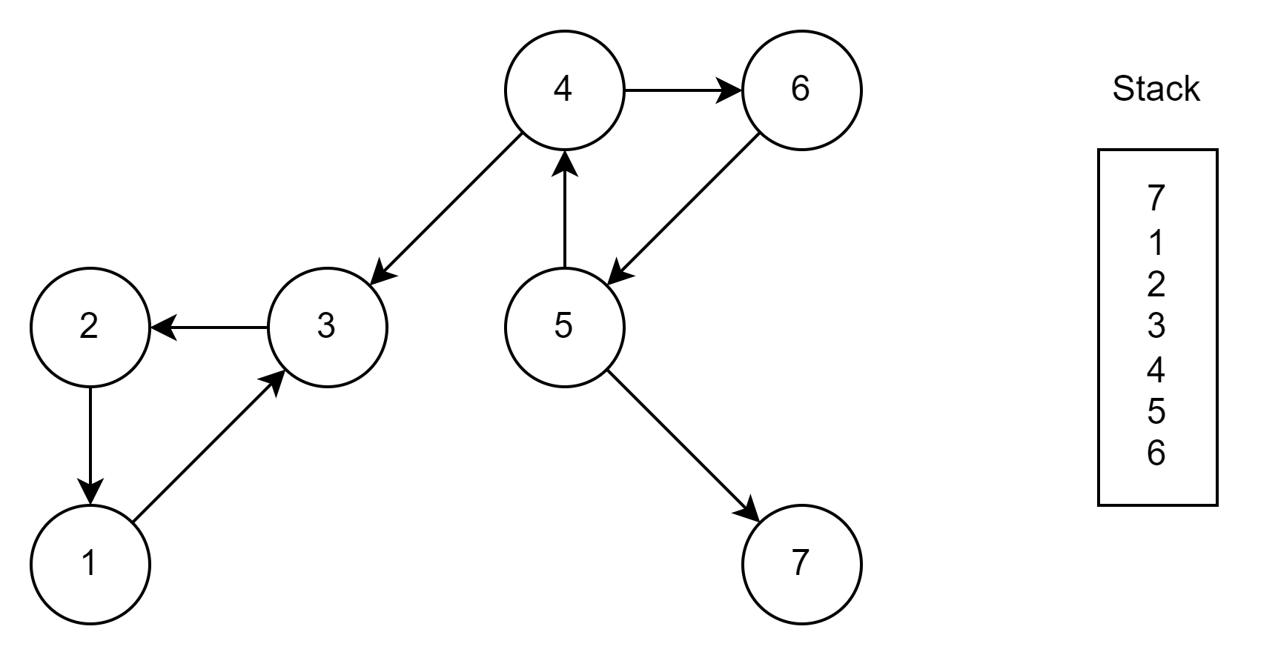
Illustration
Now, we will compute Transpose of graph and using the stack apply DFS on it to get SCCs of the graph.

Slide 22
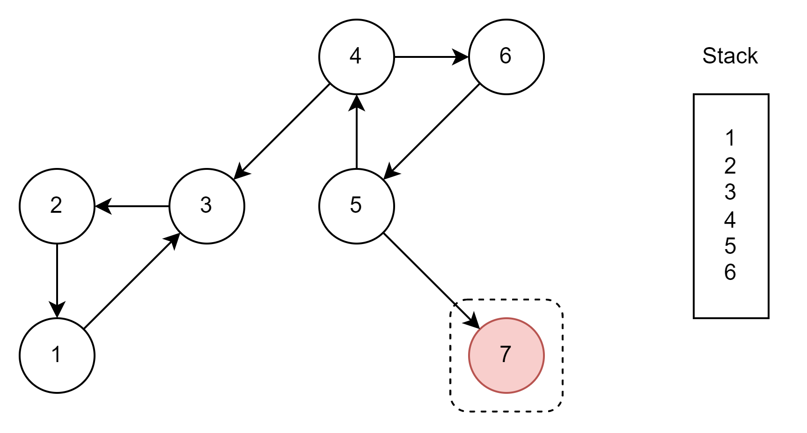
Illustration
Current

Slide 23
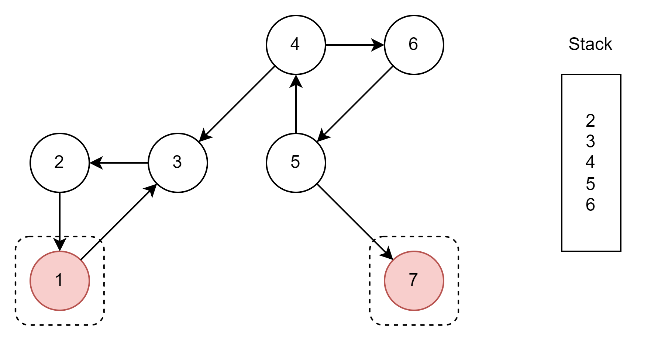
Illustration
Current

Slide 24
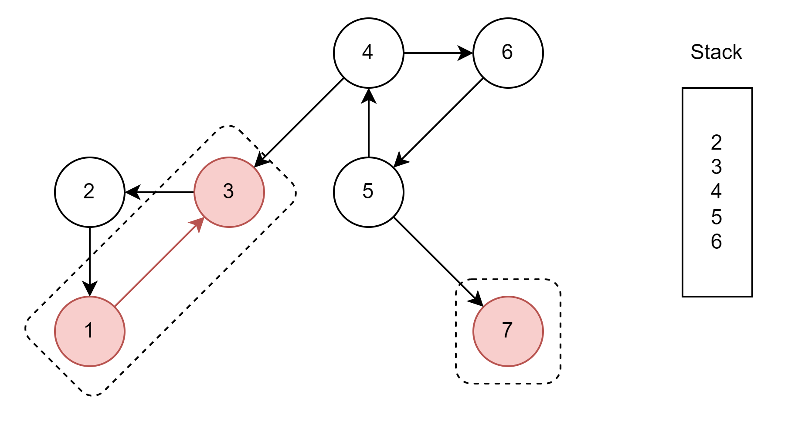
Illustration
Current

Slide 25
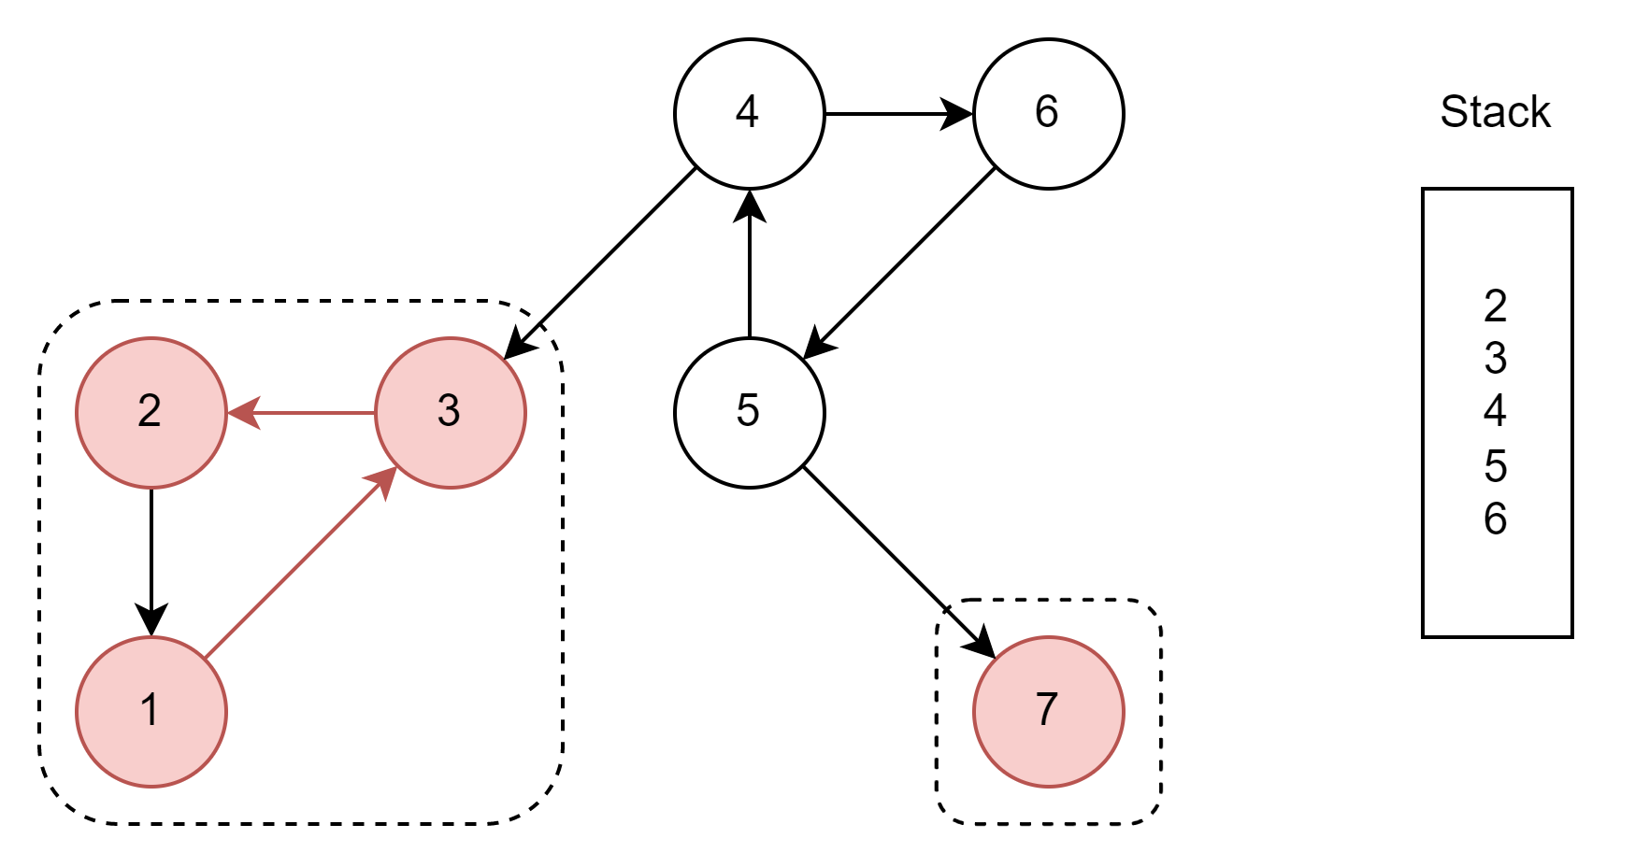
Illustration
Current

Slide 26
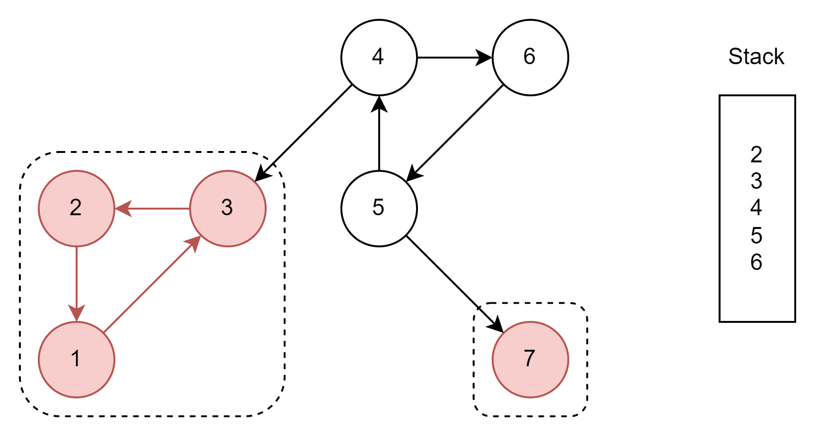
Illustration
Current

Slide 27

Illustration

Slide 28

Illustration

Slide 29
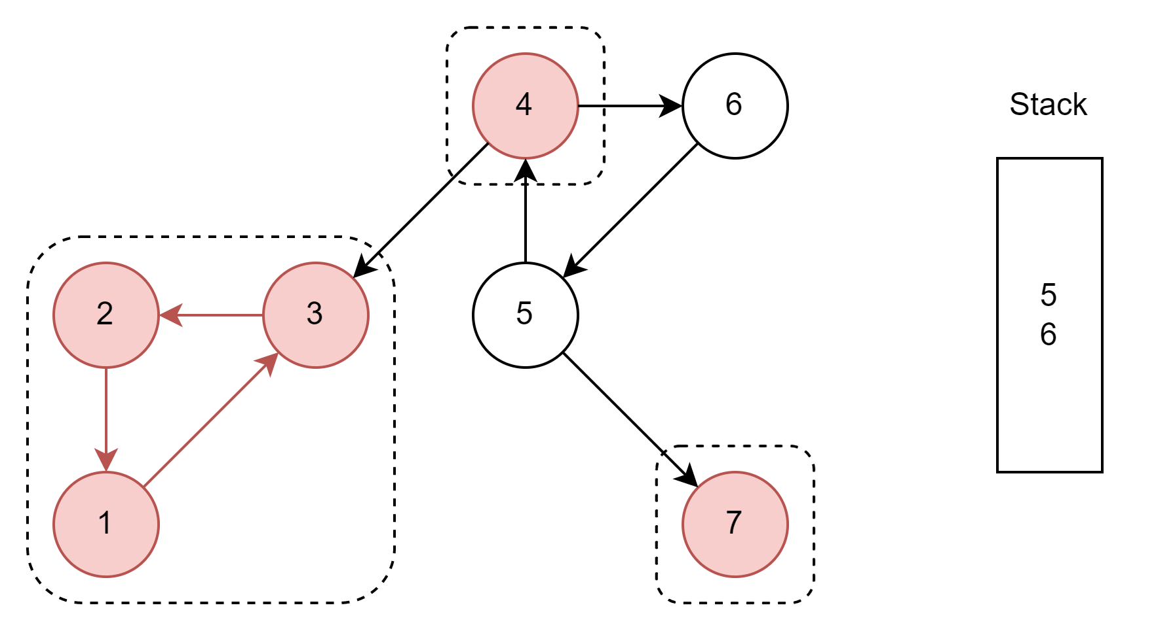
Illustration
Current

Slide 30
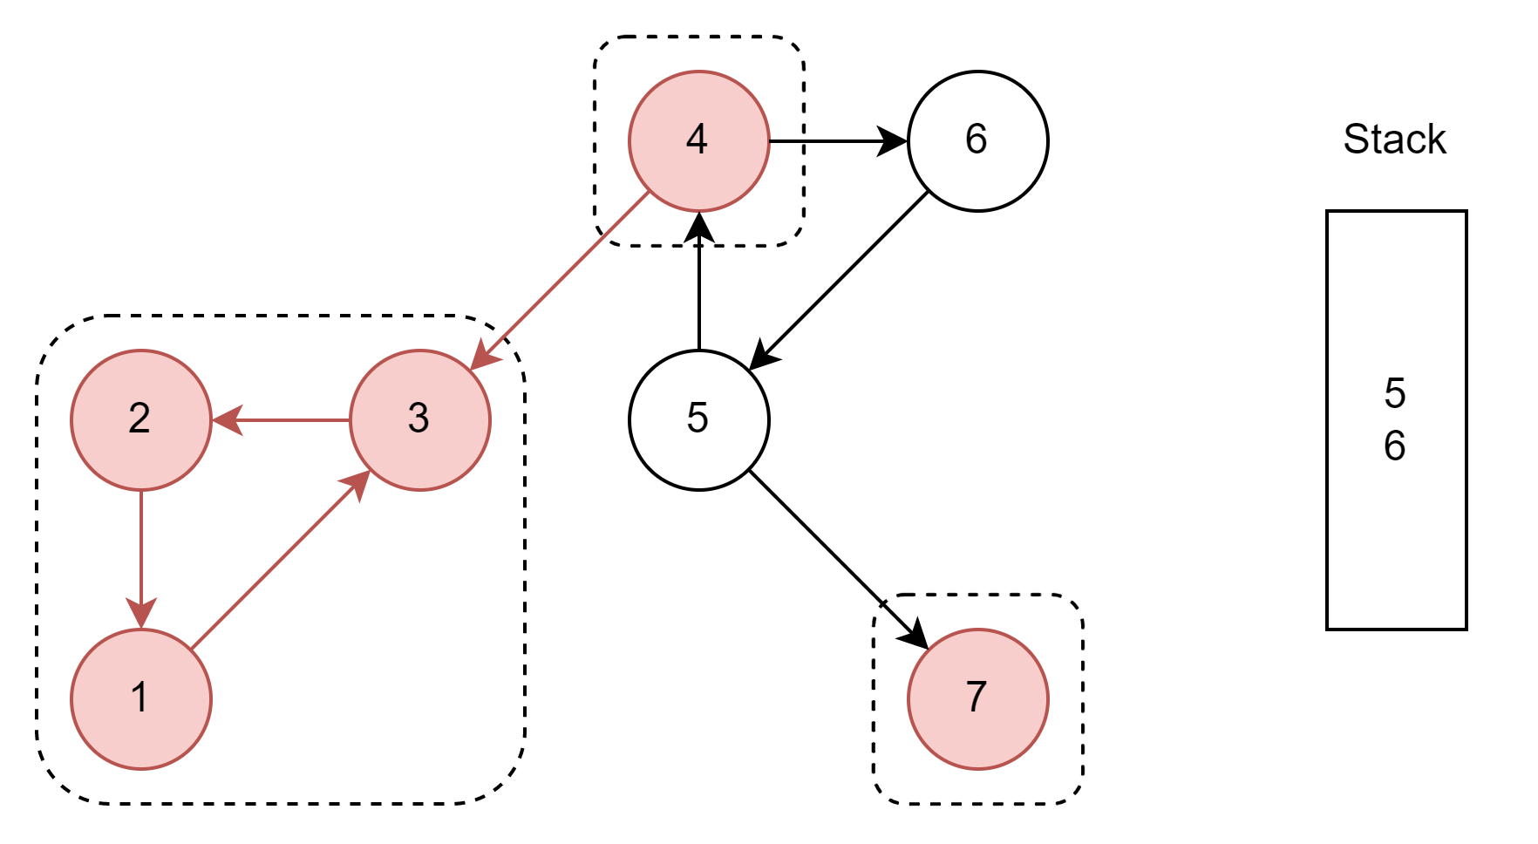
Illustration
Current

Slide 31
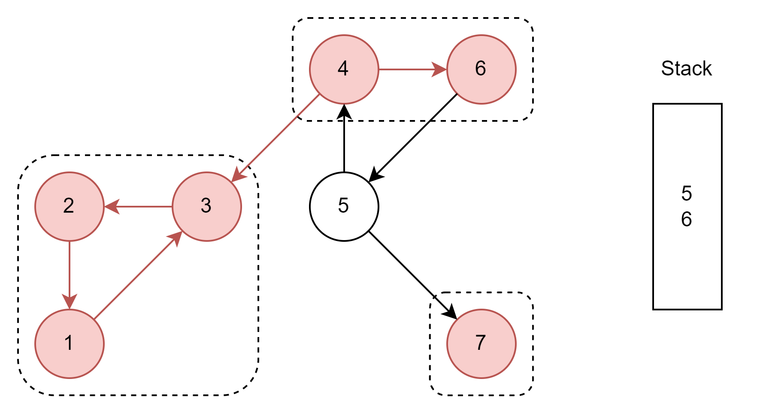
Illustration
Current

Slide 32
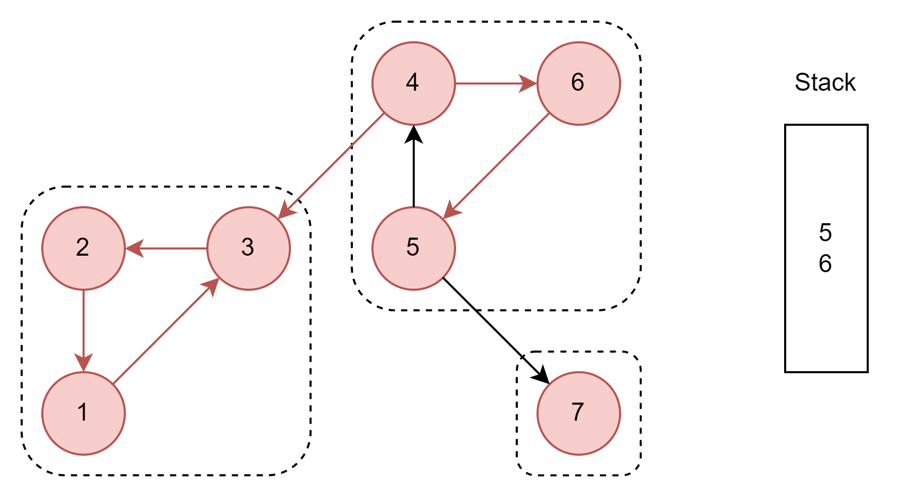
Illustration
Current

Slide 33

Illustration
Current

Slide 34

Illustration
Current

Slide 35

Illustration

Slide 36

Illustration

Slide 37

Illustration – Final SCC_{s}

Slide 38
Time complexity
Time Complexity for Kosaraju’s Algorithm = T₁ + T₂ + T₃, where
T₁ = Time for first DFS in G to construct stack = O(V + E),
T₂ = Time to compute transpose (G^{T}) = O(E),
T₃ = Time for second DFS to get SCCs = O(V + E)
Thus, Time Complexity for Kosaraju’s Algorithm = O(V + E), where
V is number of vertices and E is number of edges in graph G.

Slide 39
Thank You

